Slide 1

Power BI Report
Power BI is a powerful business intelligence tool that allows you to create visually stunning reports and dashboards to gain insights from your data. This presentation will guide you through the process of building a simple, yet effective Power BI report.
AB
by Ayush Bhushan

Slide 2

Introduction to Power BI
1
What is Power BI?
2
Key Features
Power BI is a suite of business analytics tools that allows you to visualize and analyze data.
Connect to various data sources, build interactive reports, and gain valuable insights from your data.
3
Benefits
Improve decision-making, increase efficiency, and drive business growth with Power BI's powerful capabilities.

Slide 3
Data Sources and Connectivity
Data Sources
Connectivity
Data Transformations
Power BI supports a wide range of data sources, including Excel, CSV, SQL databases, and cloud services.
Easily connect to your data sources and import data directly into Power BI for analysis and visualization.
Utilize Power BI's data transformation tools to clean, shape, and prepare your data for reporting.

Slide 4

Data Modeling and Transformation
1
Data Modeling
Design an effective data model by identifying relationships between your data tables and defining the appropriate data types.
2
Data Transformation
Use Power BI's intuitive data transformation tools to clean, format, and prepare your data for analysis.
3
Measures and Calculations
Create custom measures and calculated columns to derive insights and enhance your reporting capabilities.

Slide 5
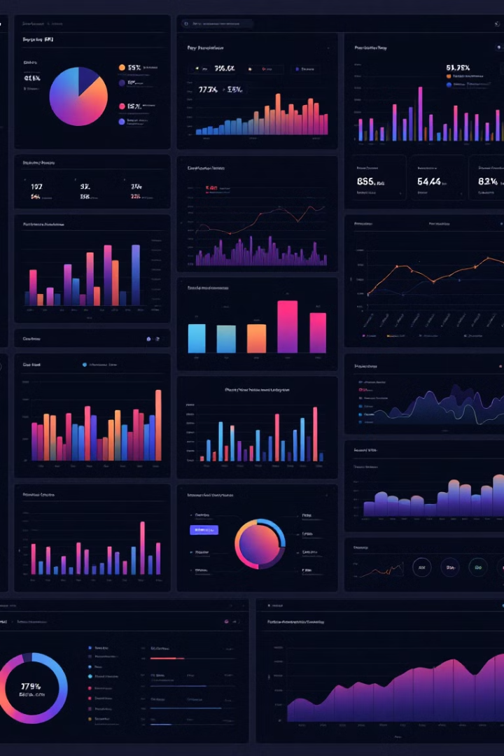
Creating Visuals and Dashboards
Chart Types
Dashboard Design
Power BI offers a wide range of chart types to visualize your data, from basic bar charts to more advanced visualizations.
Arrange your visuals strategically on the dashboard to provide a clear and comprehensive view of your data.
Interactivity
Storytelling
Incorporate interactive features like filters and drill-downs to allow users to explore the data in depth.
Use Power BI's report features to create a compelling narrative and communicate insights effectively.

Slide 6
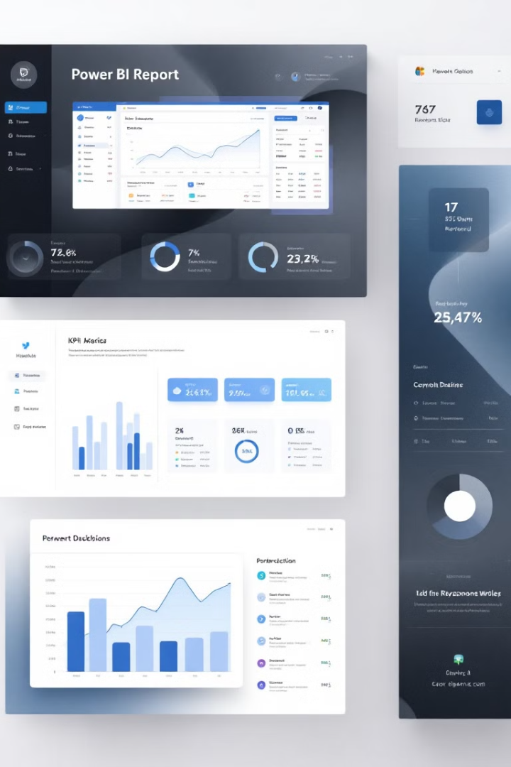




Formatting and Styling the Report
Themes
Typography
Apply pre-built themes or create custom themes to ensure a consistent visual style across your reports.
Choose appropriate font styles and sizes to enhance readability and improve the overall aesthetic of your report.
Color Palette
Layout
Carefully select a color palette that aligns with your brand and highlights the key information in your report.
Arrange the visual elements on your report canvas to create a clean, organized, and visually appealing layout.

Slide 7




Interactivity and User Experience
Filters
Drill-Down
Interactions
Empower users to explore data by implementing intuitive filtering options, such as slicers and dropdowns.
Allow users to dive deeper into the data by incorporating drill-down functionality into your visuals.
Leverage dynamic interactions, such as cross-highlighting and tooltips, to enhance the user experience.

Slide 8
Sharing and Publishing the Report
Publish to Web
Embed in Applications
Collaboration
Share your reports by publishing them to the Power BI service, making them accessible to stakeholders.
Integrate your Power BI reports into your own applications or websites for a seamless user experience.
Leverage Power BI's collaboration features to invite users, assign permissions, and gather feedback.

Slide 9

Maintaining and Updating the Report
1
Scheduled Updates
Set up regular data refreshes to ensure your reports always display the latest information.
2
Report Maintenance
Continuously review and optimize your reports to improve their performance and user experience.
3
Feedback and Iteration
Gather feedback from stakeholders and continuously iterate on your reports to better meet their needs.

Slide 10

Best Practices and Tips for Power BI Reporting
1
Focus on Usability
2
Leverage Visualizations
Design your reports with the end-user in mind, ensuring they are intuitive and easy to navigate.
Choose the right chart types to effectively communicate your data insights and tell a compelling story.
3
Optimize Performance
4
Continuous Improvement
Implement best practices to ensure your reports load quickly and perform well, even with large data sets.
Regularly review and update your reports to keep them relevant and aligned with evolving business needs.

